Slide 1
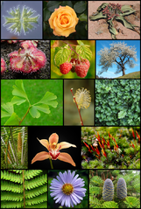
What plant grows the most abundantly on Earth?
Notes:
Algae: Tiny Plants with Big Energy Potential Lesson > TeachEngineering.org
///
We’re going to start today’s lesson with a challenge question: What plant grows the most abundantly on Earth? In groups, talk about which plant grows the most and agree upon an answer. (Expect answers such as “trees.”)
The correct answer is algae—which are very small plants that grow in such huge numbers that they provide nearly half of the air we breathe—which they produce while they are making their own food. We are going to talk about algae and how we can use it for energy.
Image source: 2009 Rkitko, Wikimedia Commons (composite of images available on Wikimedia Commons; CC BY-SA 3.0 and GFDL) https://commons.wikimedia.org/w/index.php?curid=6412607

Slide 2
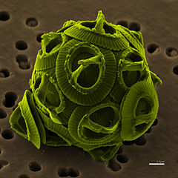
Algae: Tiny Plants with Big Energy Potential
Notes:
Algae are very small. Some are too small to see without a microscope, such as shown in this high-magnification photograph. But since they grow so fast in many different biomes, we can use them to make a renewable energy source called biofuel.
Image source:
(Microscopic photo) 2007 NEON ja, colored by Richard Bartz, Wikimedia Commons CC BY-SA 2.5 https://commons.wikimedia.org/w/index.php?curid=6072505

Slide 3
Learning Objectives for Today
What are similarities and differences between biofuels and fossil fuels?
What are algae? What can biological engineers make out of algae?
Why is breaking the algal cell wall important for biological engineers?
Notes:
Today’s learning objectives. These are the questions that we will explore during the lesson. By the end of the lesson, you will know the answers.
For instructor reference, the answers are provided in bold below.
What are similarities and differences between biofuels and fossil fuels? Both come from plants or other living things. But biofuels can be made in hours or days, while fossil fuels take millions of years to be created.
What are algae and what can biological engineers make out of algae? Algae are very small plants that live in water. Biological engineers use them to make biofuels for three reasons: 1) they have 3 parts that can be made into biofuel, 2) they grow very fast and 3) using them for fuel does not waste food since people do not usually eat this type of algae. Note that seaweed is a type of algae and people DO eat seaweed.
Why is breaking the algal cell wall important for biological engineers? Biological engineers need to break down the cell wall to get to the starch and oil inside the cells. The broken-down cell walls can also be made into biofuel.

Slide 4
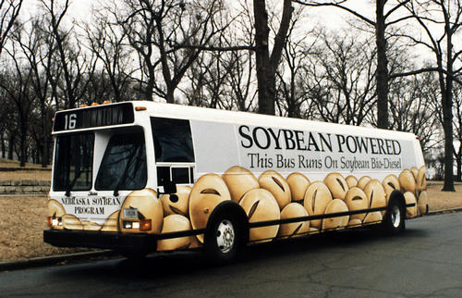
Chemicals from plants that we can use for energy
Biofuels
What is another source of chemical energy?
How are oil, coal and natural gas different than biofuels?
Notes:
Please write down in your notebooks the definition of biofuels. (click to reveal definition) Biofuels are chemicals from plants that we can use for energy (chemical energy). The bus in this photograph is designed to use biofuel from soybeans (a plant) to run, instead of fossil fuels (like oil, gasoline, diesel, natural gas) like many buses and cars.
(click to reveal question) What is another source of chemical energy? Answers: Fossil fuels, batteries, food, firewood.
(click to reveal question) How are oil, coal and natural gas different than biofuels? Biofuels are different from fossil fuels such as oil, coal and natural gas because they can be made in hours or days, not millions of years like fossil fuels.
Image source: (soybean-powered bus) 2010 U.S. Government, Wikimedia (public domain) https://commons.wikimedia.org/w/index.php?curid=12037773\

Slide 5
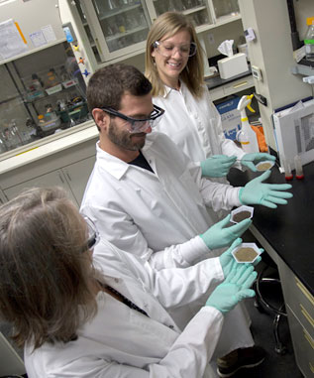
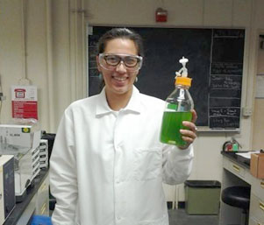
People who apply their knowledge about living things to solve problems
Biological engineers work with farmers, doctors and scientists
Biological engineers
Describe a problem that biological engineers might be able to help you with…
Notes:
(click to reveal definition) Biological engineers are experts in biology but also use math, physics, chemistry, mechanical systems and computer technology to solve problems. These photos show biological engineers at work growing algae for biofuels and examining different types of plants and compost for improving soil for farming.
(click to reveal question) Describe a problem that biological engineers might be able to help you with. Correct answers include: new watering techniques to help plants survive droughts, a medicine needs to be developed for a new type of illness, a certain kind of food contains harmful bacteria and new processing or quality control methods are needed, to develop a biofuel to replace the use of fossil fuels, and picking strawberries requires crouching in uncomfortable positions for a long time.
Image sources:
(engineer & green liquid) 2016 Lauren Jabusch (author), University of California Davis
(3 engineers in lab coats) Courtesy of VanderGheynst Lab.

Slide 6
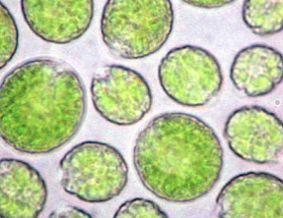
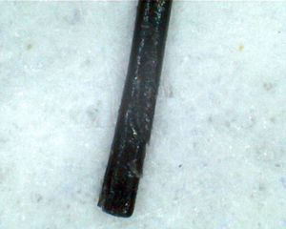
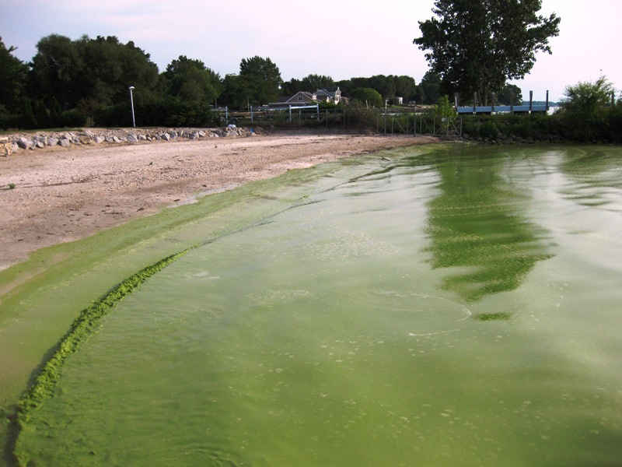
Algae are Super Plants
Algae are one type of teeny tiny plant that you can find growing in lakes, ponds and swimming pools
Notes:
This photograph shows a blue-green algae bloom in Lake Erie. You may have seen algae growing like this in natural waterways or pools. (click to show additional pictures)
Ask students: What do you think we’re looking at in the photo to the right? (It might take them a bit to guess that it is a human hair.)
These microscopic photos, both at 400x magnification, show how small algal cells are compared to human hair.
Image sources:
(algae bloom in Lake Erie) 2009 NASA, NOAA, Wikimedia Commons (pubic domain) https://commons.wikimedia.org/wiki/File:Blue-gree_algae_bloom_Lake_Erie.png
(microscopic algal cells 400x) Phil Gates, Beyond the Human Eye (blog) http://beyondthehumaneye.blogspot.com/2012_04_01_archive.html
(microscopic human hair 400x) 2011 Saurabh R. Patil, Wikimedia Commons CC BY-SA 3.0 https://commons.wikimedia.org/wiki/File:Human_hair_at_400X.jpg
///
For photo of microscopic algal cells: “Copyright Notice: Copyright of all photographs on this blog resides with Phil Gates. Students and teachers are welcome to use any of these photographs for non-commercial educational purposes free of charge, provided that their source is acknowledged by quoting the URL of this blog. The size and resolution of most pictures should be fine for PPT presentations.”

Slide 7
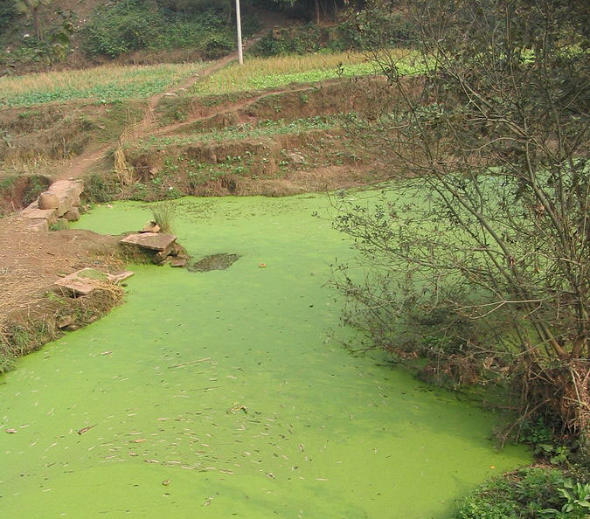
Very small plants
Algae
Live in water in many places around the world
They grow fast
Notes:
Record in your notebooks the definition of algae. Algae is plural; alga is singular. (click to reveal the definition) Very small plants. (click) Live in water in many places around the world. (click) They grow fast.
Have you ever seen a pond that looks like this, with algae covering the water surface? And here’s what algae looks like under a high-powered microscope.
Image sources:
(Pond photo) 2005 Felix Andrews (Floybix), Wikimedia Commons GNU Free Doc Lic v1.2+ https://commons.wikimedia.org/w/index.php?curid=1092921
(Microscopic photo) 2007 NEON ja, colored by Richard Bartz, Wikimedia Commons CC BY-SA 2.5 https://commons.wikimedia.org/w/index.php?curid=6072505

Slide 8
Algae grow “like weeds”
The types of algae that many engineers use grow twice their size in a day! That’s fast.
Compared to human growth, it would be like:
On Monday, you weigh 50 pounds
By Tuesday, you weigh 100 pounds.
How much would you weigh on Wednesday?
By Friday, you would weigh 800 pounds!
From where does the alga growth come?
Notes:
Algae grow very fast.
[Expect students to be able to follow the number sequence to calculate the weight of the algae for the days of the week.]
On Monday, you weigh 50 pounds. (click) By Tuesday you weigh 100 pounds. (click) How much would you weigh on Wednesday? 200 pounds. And how much on Thursday? 400 pounds. (click to show Friday)
(click to show next question) From where does the alga growth come? Plants grow through photosynthesis. (This is a transitional leading question, although some students may already be familiar with photosynthesis.)

Slide 9
Plants Photosynthesize
Photo = light
Synthesize = to make, usually a chemical
light
carbon dioxide
sugars
water
Notes:
Look at the parts of the word “photosynthesis” to understand its meaning. (click to show) Photo means light and (click) synthesize means to make, usually a chemical. Plants use light to make chemicals—most importantly carbohydrates/sugars. Plants use the sugar for energy.
Plant roots absorb water and their leaves take in carbon dioxide from the air and light from the sun. Then plants use these ingredients to make sugar. Plants use the sugar they make for energy, just like we eat food (and sugar) for energy. The difference is that plants make their own sugar from sunlight, water and carbon dioxide.
To recap, what is the story of photosynthesis? Plants use sunlight, water and carbon dioxide to make sugars for energy.

Slide 10
Why do biological engineers use algae for biofuels?
Algae grow very fast
Algae grow in many places around the world
People do not usually eat algae
We can make biofuel from three parts of algal cells
Notes:
In groups, think of reasons why biological engineers might want to use algae for biofuels.
Reasons that we have talked about so far are: 1) they grow very fast and 2) they grow in many different places around the world. (click to show these two answers on the slide)
In addition, algae are good plants to make into biofuels because we don’t eat them. We don’t want to take away food for people in order to make fuel. (click to show that reason)
Algae make oil and sugars inside their cells. We remove those oils and sugars to make into fuels that are considered renewable. We can also make fuel out of algal cell walls. (click to show that reason)

Slide 11
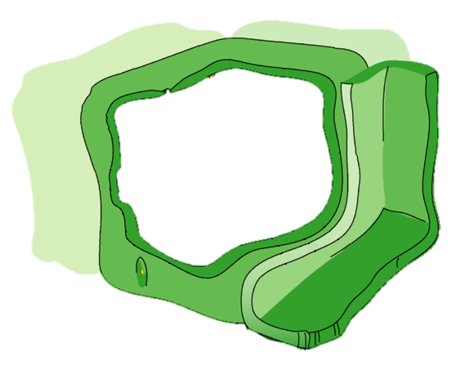
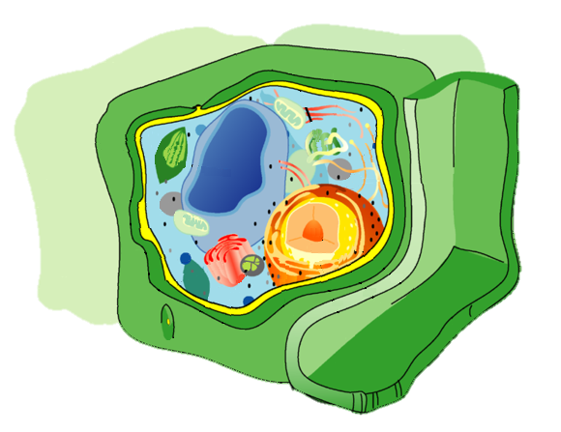
3 Parts of Algae We Make into Fuel
Oil
Starch
(made of sugar)
Cell wall
(made of sugar)
Notes:
Three parts of algae can be turned into energy. Look at this cartoon sketch of a plant cell. (click to advance animation) If we ignore the organelles of the cell, we see this simplified view of the plant cell. The parts of the algae we can use to make into fuel are (click) oil, (click) starch and (click) the cell wall.
For this lesson, we are going to focus on the cell wall. To get to the oils and starch, we need to break apart the cell wall. And, we can use the broken-down cell wall for fuel, too.
Teacher note: The depicted plant cell is shown with adjacent cells; algae can be single-celled or multicellular.
Image source:
(Diagram of plant cell w cell wall in green) 2009 LadyofHats, Wikimedia Commons [public domain] https://commons.wikimedia.org/wiki/File:Eukaryota_cell_strucutre.PNG
Animation and additional drawings added by author Lauren Jabusch, University of California Davis

Slide 12
Very small plants
Live in water in many places around the world
They grow fast
People don’t usually eat algae
Composed of oil, starch and cell walls
Algae
Notes:
(click 3 times to show first 3 items) Add the following to your notes about algae: (click to show) “People don’t usually eat algae” and (click) “Composed of oil, starch and cell walls.”
Image sources:
(Pond photo) 2005 Felix Andrews (Floybix), Wikimedia Commons GNU Free Doc Lic v1.2+ https://commons.wikimedia.org/w/index.php?curid=1092921
(Microscopic photo) 2007 NEON ja, colored by Richard Bartz, Wikimedia Commons CC BY-SA 2.5 https://commons.wikimedia.org/w/index.php?curid=6072505

Slide 13
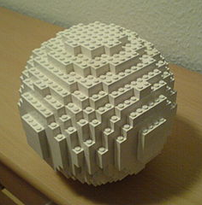
Cell Wall Analogy
=
Notes:
As an analogy, think about the algal cell wall like a box made of LEGO pieces. How would you open this LEGO container (box, orb)? Expect students to say that they would take apart the box, piece by piece, using their fingers. I agree that it is better to take apart the LEGO container piece by piece so that we can reuse the pieces for other projects and because it would take less effort than, say, smashing it with a hammer or heating in an oven until the pieces melted. Raise your hand if you think it would be ridiculous to smash or melt the LEGO orb. I agree with you. It would be silly to use energy-intensive or wasteful methods to open the LEGO box.
Biological engineers face a similar challenge with cell walls. Right now, engineers only know how to open the cell wall with energy-intensive methods like using the hammer to smash or the oven to melt. But, if we knew more about the LEGO bricks—which represent the sugars present in the cell walls—we could open the cell walls using less energy and reuse the sugar for biofuels. So the research continues.
Image sources:
(LEGO orb) 2006 Jérôme Kunegis, Wikimedia Commons GNUFDL 1.2+ https://commons.wikimedia.org/wiki/File:Sph%C3%A8re_Lego_blanche.jpg
(Diagram of a plant cell; the cell wall is green) 2009 LadyofHats, Wikimedia Commons [public domain] https://commons.wikimedia.org/wiki/File:Eukaryota_cell_strucutre.PNG

Slide 14
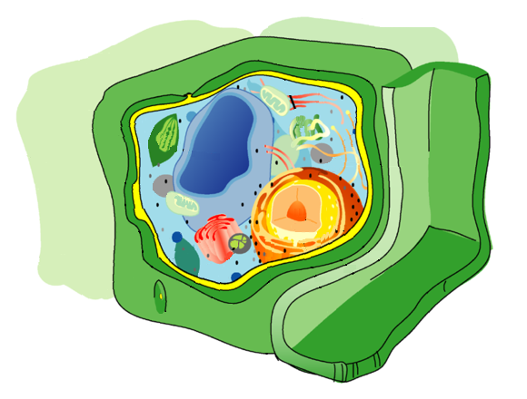
A structure made of sugar that surrounds and protects a cell
Cell wall
Cell wall sugars can be used to make more biofuel
Notes:
The definition of the algal cell wall is: (click to reveal answer) a structure made of sugar that surrounds and protects the cell, and (click) the cell wall sugars can be used to make more biofuel.
Biological engineers study algae to find ways that we can more easily make biofuel by opening the cell walls to get to the oil and starch, and by recycling the sugars of the cell wall into biofuel.
Image source:
(diagram of a plant cell; the cell wall is green): 2009 LadyofHats, Wikimedia Commons [public domain] https://commons.wikimedia.org/wiki/File:Eukaryota_cell_strucutre.PNG

Slide 15
Review
Why are algae good for biofuels?
Algae grow very fast
Via photosynthesis, algae make sugars and oils
Humans do not think algae are tasty, so we can use these oils and sugars to make fuel
What parts of algae can be made into biofuels?
3 components of algal cells can be made into fuel: oils, starch and the cell wall.
Notes:
(Click to reveal questions and answers)

Slide 16
Review (continued)
Why do we want to know about the sugars of the cell wall?
Knowing what types of sugar “LEGO pieces” make up algal cell walls helps us learn how to take them apart without using energy-intensive methods like smashing or melting
If we know what sugar “LEGO pieces” we have, we can recycle them into new chemicals
Notes:
(Click to reveal question and answers)

Slide 17
Lesson Extension
Slides 17-20
How do people grow algae for biofuels?
Notes:
[Lesson extension slides. These are optional enrichment slides.]
We’ve talked a lot about how we can use algae for biofuels and how fast algae grow, but we have not talked much about ways to grow algae. Let’s learn about a few different ways.

Slide 18
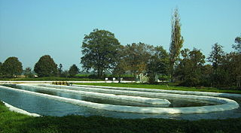
A way to grow large quantities of algae
Raceway ponds
Farmers use raceway ponds
Notes:
Raceway ponds are a (click to reveal) way to grow very large quantities of algae. (click to reveal) Farmers use raceway ponds because they are inexpensive to build for the quantity of algae they can produce.
Image source: 2011 JanB46, Wikimedia Commons CC BY-SA 3.0 https://commons.wikimedia.org/wiki/File:Microalgenkwekerij_te_Heure_bij_Borculo.jpg

Slide 19
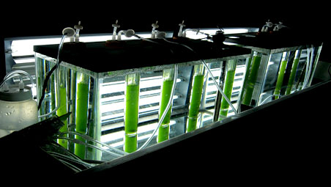
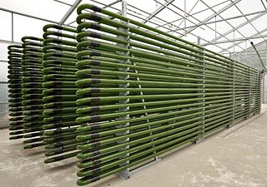
A way to grow small to large amounts of algae
Photobioreactor
Engineers and farmers use photobioreactors
Notes:
Photobioreactors: First, let’s break down the word. A reactor is a place where a reaction happens so a photobioreactor is a place where a light-life reaction takes place. Can you think of a process that living things do that uses light? Photosynthesis Yes! Photosynthesis is happening in these tubes, which are designed to give the algae lots of light. (click to reveal) Photobioreactors can grow small to large amounts of algae but cost more than raceway ponds to build and maintain. (click) Biological engineers and farmers use photobioreactors. Why do you think photobioreactors are more expensive than raceway ponds? They require more materials [glass or plastic for tubing, metal for stands] than the raceway ponds and the more complex equipment requires trained people to maintain it.
Image sources:
Left image: Courtesy of the VanderGheynst Lab.
Right image: 2013 IGV Biotech, Wikimedia Commons CC BY-SA 3.0 https://commons.wikimedia.org/wiki/File:Photobioreactor_PBR_4000_G_IGV_Biotech.jpg

Slide 20
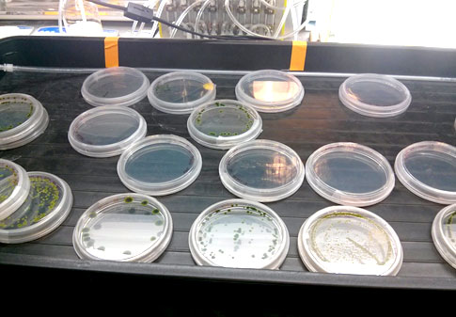
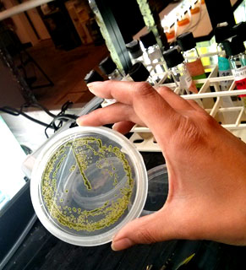
A way to grow small amounts of algae
Petri dishes
Engineers use petri dishes for experiments
Notes:
Petri dishes are used to grow (click to reveal) small amounts of algae for testing and experimentation. (click to reveal) Biological engineers use petri dishes, which have a thin layer of gel at the bottom, to examine algae during lab experiments.
Image sources: 2016 Lauren Jabusch (author), University of California Davis

