Slide 1
How to Build a Piezoelectric Generator
Notes:
How to Build a Piezoelectric Generator Presentation, Building a Piezoelectric Generator activity > TeachEngineering.org

Slide 2
Circuit Design
LED
piezoelectric element
Notes:
A circuit diagram shows an AC voltage source (piezo element) connected past a switch to a capacitor and LED.
Image source: 2014 Matthew Zelisko, GK-12 Program, University of Houston

Slide 3
How Much Energy is Generated?
The energy stored in a capacitor is given by the equation:
$$E= \frac{1}{2}V^{2}C$$
For our circuit, C = 220 µF. When the multimeter shows 10 volts across the capacitor, the amount of energy stored is
$$E= \frac{1}{2}{\left(10 V\right)}^{2}\left(220 μF\right)=0.011 joules$$
If a single tap on the piezoelectric element increases the voltage from 2 V to 2.05 V, the amount of energy generated for each tap is
$$E= \frac{1}{2}{(2.05}^{2}−2^{2})(220 μF)=0.000022 joules/tap$$
Notes:
Image source: (lightning bolt) Microsoft clipart at http://office.microsoft.com/en-us/images/results.aspx?qu=lightning&ex=1#ai:MC900441735|

Slide 4

How Much energy is 0.000022 Joules?
A typical cell phone battery stores ~18,000 joules of energy.
If we replaced our capacitor with a cell phone battery to charge, how long would it take to fully charge it?
$$\frac{18,000 joules}{0.000022 joules/tap}≈820,000,000 taps$$
You would have to press this piezoelectric element almost 1 billion times just to charge your cell phone!
If you tapped the piezo element 3 times every second, it would take 8.66 years to fully charge your cell phone.
Notes:
Image source: 2014 Denise W. Carlson, ITL Program, College of Engineering, University of Colorado Boulder

Slide 5
How can we Make A practical Piezoelectric Generator?
Two obvious ways to improve our piezoelectric generator:
Use a more efficient piezoelectric material
Place the piezoelectric element where it will get pressed very rapidly
If we have a piezoelectric material that can increase the voltage across our capacitor from 2 V to 12 V with a single tap, the amount of energy generated is now 0.0154 joules/tap, 700 times greater than before.
It would now only take 1,200,000 taps to charge the cell phone, which could be done in 4.6 days!

Slide 6
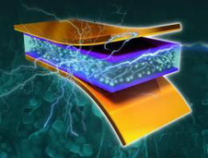
How can we make a practical Piezoelectric generator?
The second choice is to place the piezoelectric element where it experiences MANY more deformations.
This has been done by placing the elements under sidewalks and roads—places where surface movement vibrations tap the element 10,000 times per second. ⬇
If our piezoelectric element could be pressed 10,000 times/second, it would take 22.8 hours to charge.
Finally, if we combined both improvements, the phone battery could be charged in as little as 2 minutes!
Notes:
Image sources:
(drawing of NASA nanowire-based piezoelectric (PE) power generation technology) NASA http://www.nasa.gov/ames-partnerships/technology/technology-opportunity-nanowire-based-piezoelectric-power-generation/#.VFRzvPnF8nE
(car traffic on highway) Microsoft clipart at http://office.microsoft.com/en-us/images/results.aspx?qu=highway&ex=1#ai:MP900442392|mt:2|

Slide 7
Questions?

Slide 8
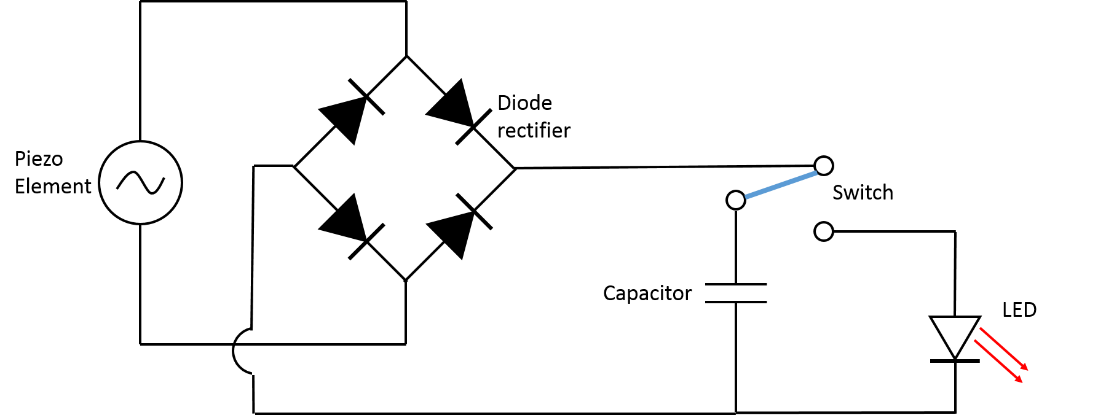
Circuit Design
Notes:
Alternate circuit diagram (Figure 1 from activity write-up); if desired, swap out for simpler circuit design on slide 2.
A circuit diagram shows an AC voltage source (piezo element) connected to a diode rectifier bridge leading past a switch to a capacitor and LED.
Diodes permit current to flow in only one direction. Making a diode rectifier bridge converts the AC voltage generated by the piezo element into a DC voltage, which can be used by the capacitor and the LED.
Image source: 2014 Matthew Zelisko, GK-12 Program, University of Houston

