Slide 1

Oh Baby! Contractions and Calculations / Activity Part 1

Slide 2
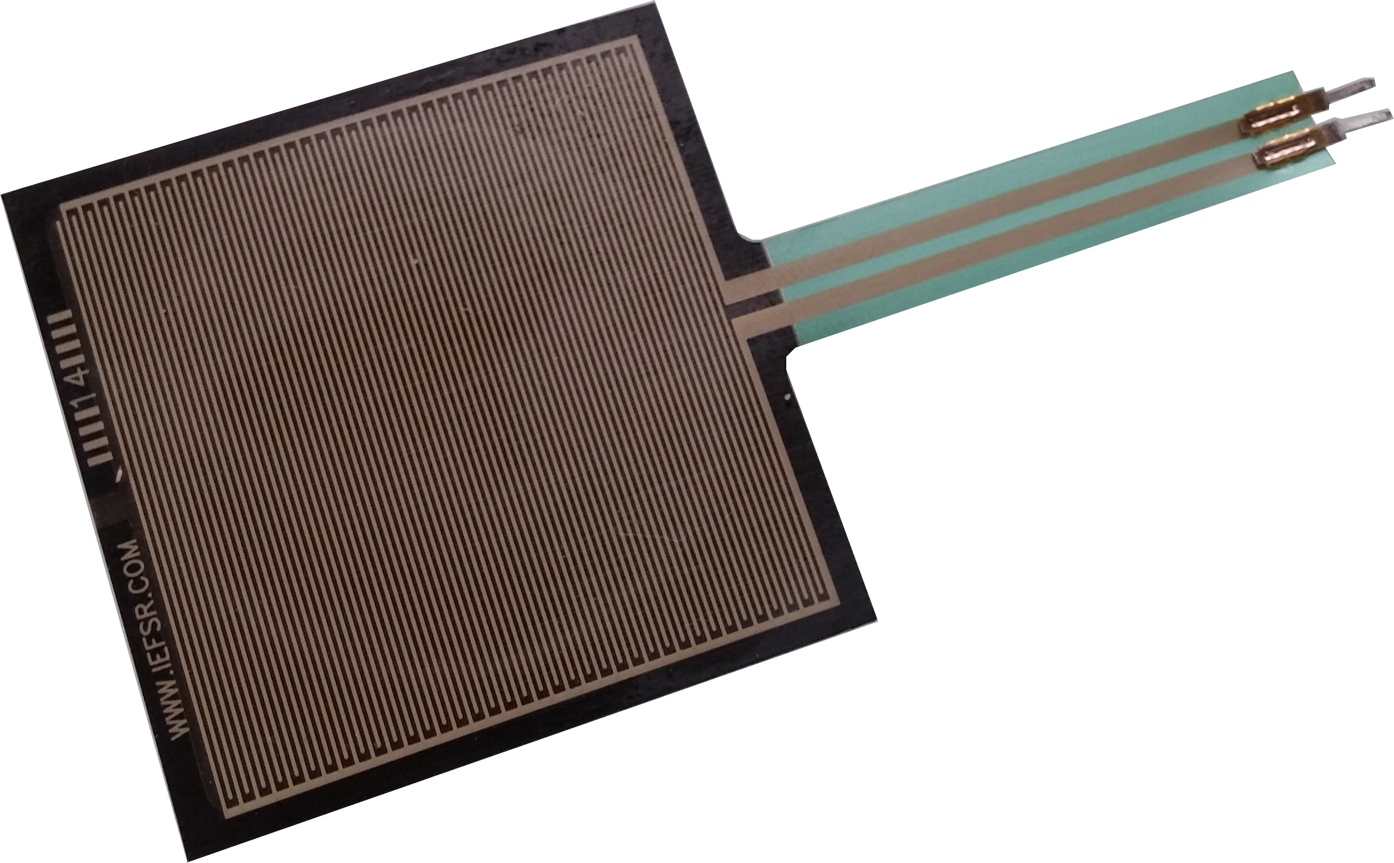
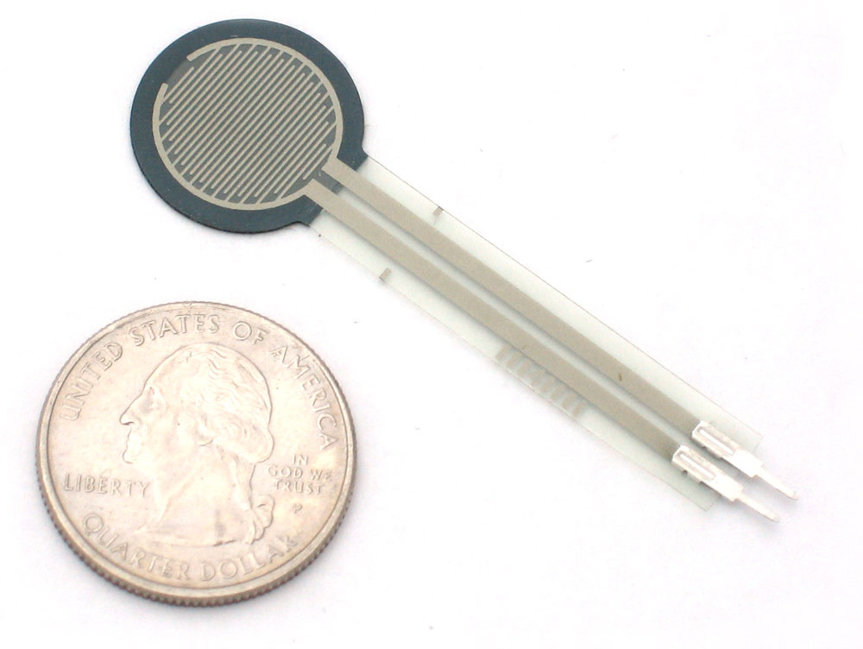
Introduction to Force-Sensitive Resistors (FSRs)
A force-sensitive resistor detects physical pressure when the component is pressed or squeezed. It is made of a thin flexible material called Thermoplastic Polyurethane or TPU. You may recognize TPU as a filament used for 3D printing, but it is more commonly known as a cell phone screen protector.
When pressure is applied to a FSR, the amount of resistive carbon elements touching the conductive traces increases or decreases, in turn, changing the resistance. An FSR acts similar to a variable resistor. FSRs are available in square and round shapes. In this activity, you will determine if increased pressure leads to increased or decreased resistance.
Square Sensitive Resistor
Round Force-Senstivie Resistor

Slide 3
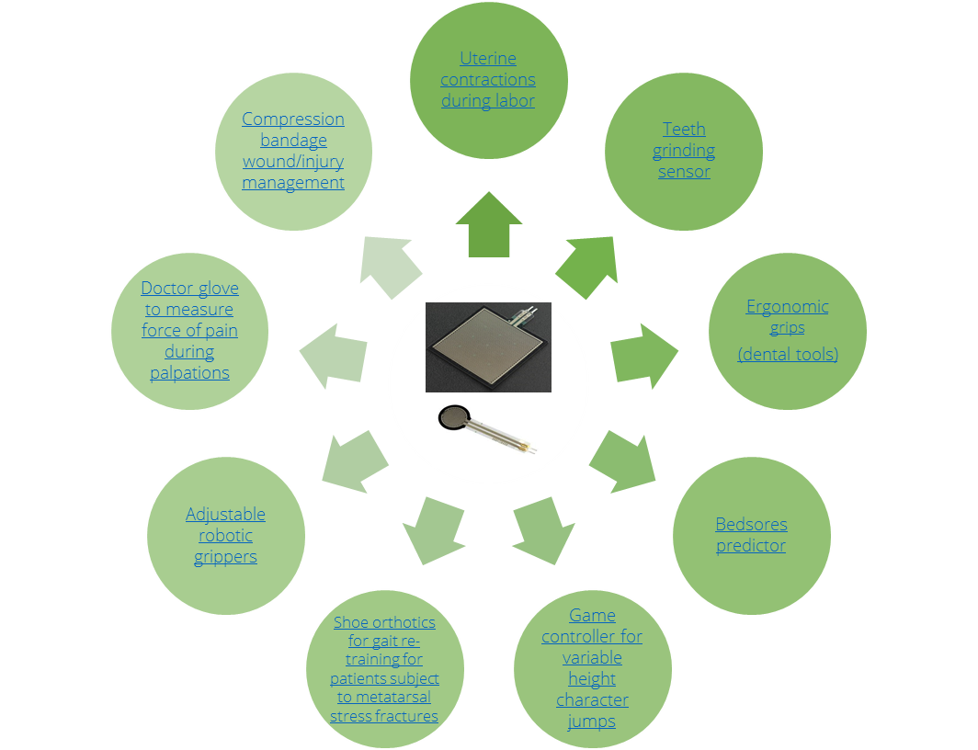
Devices with FSRs
The Concept Map shows uses of FSRs in existing products as well as in products undergoing developmental research and design.
Can you think of any more uses?
Concept Map

Slide 4
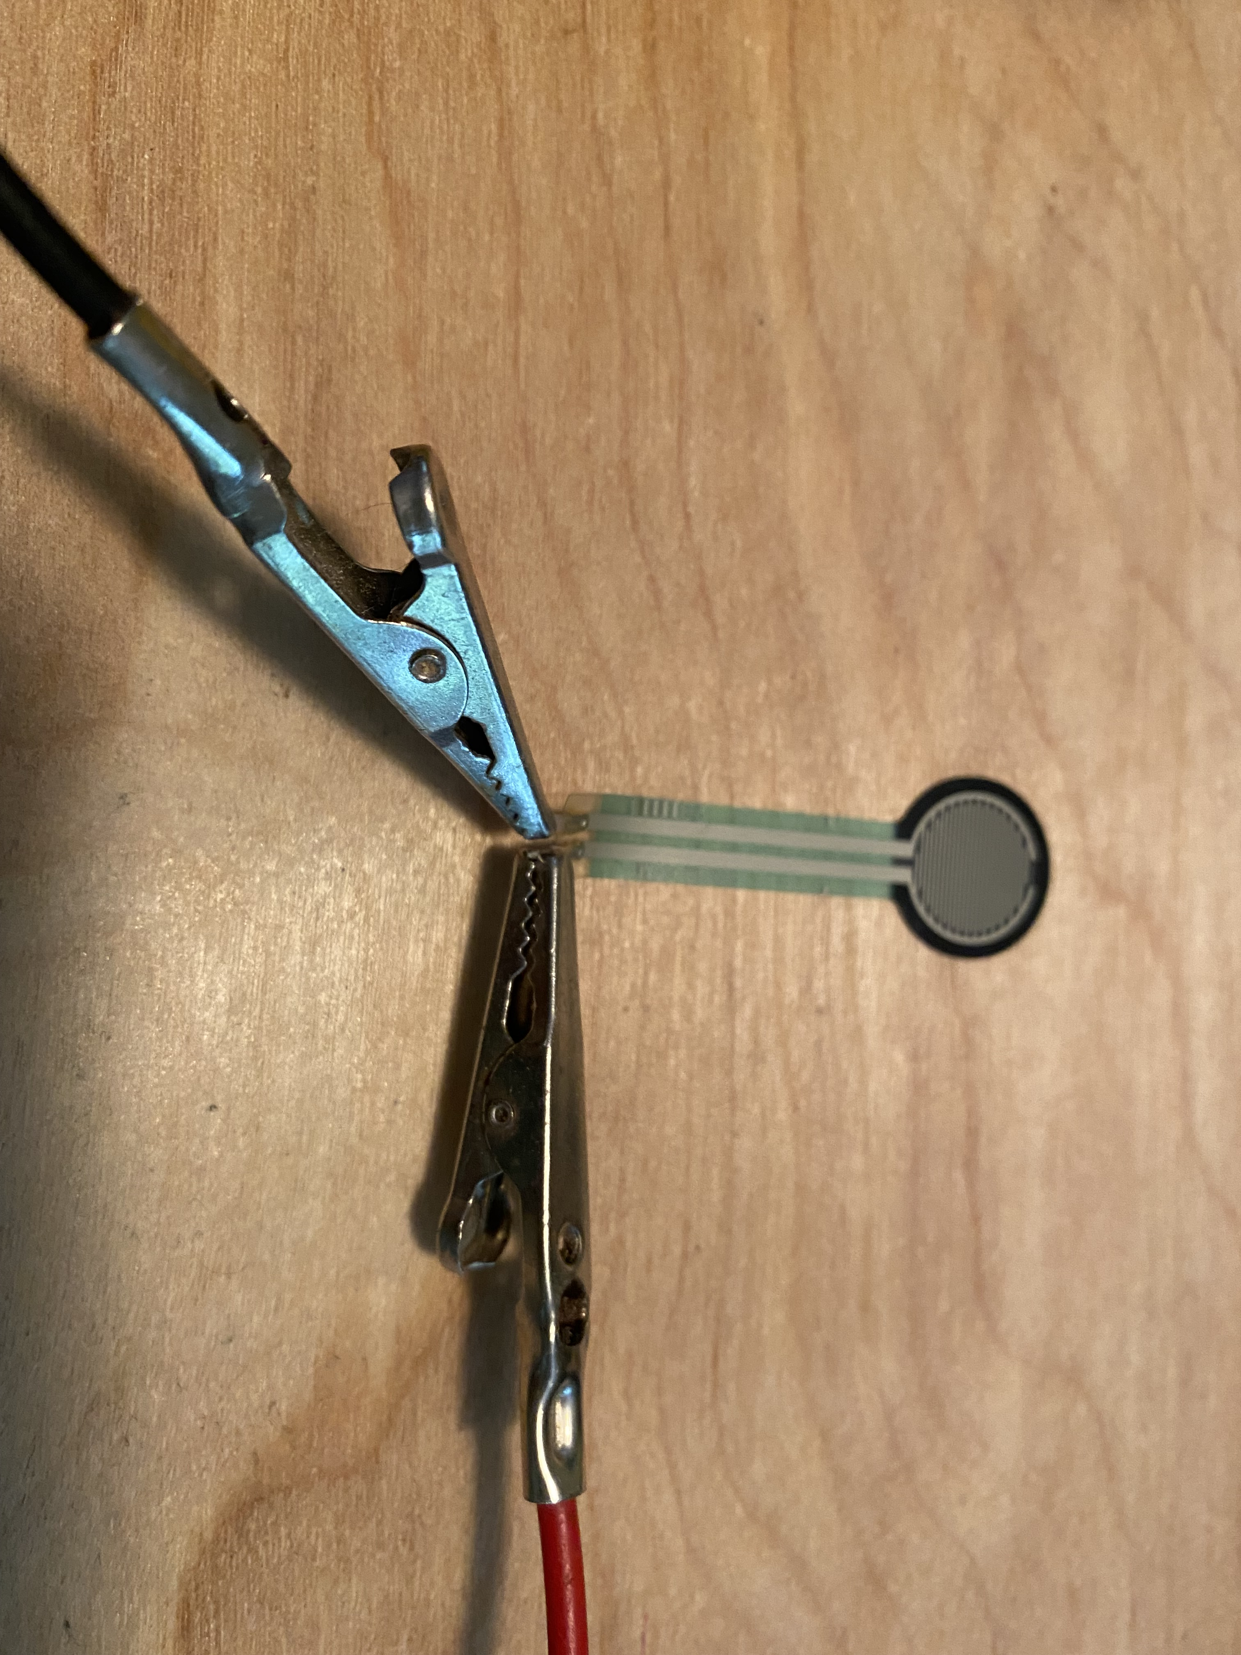
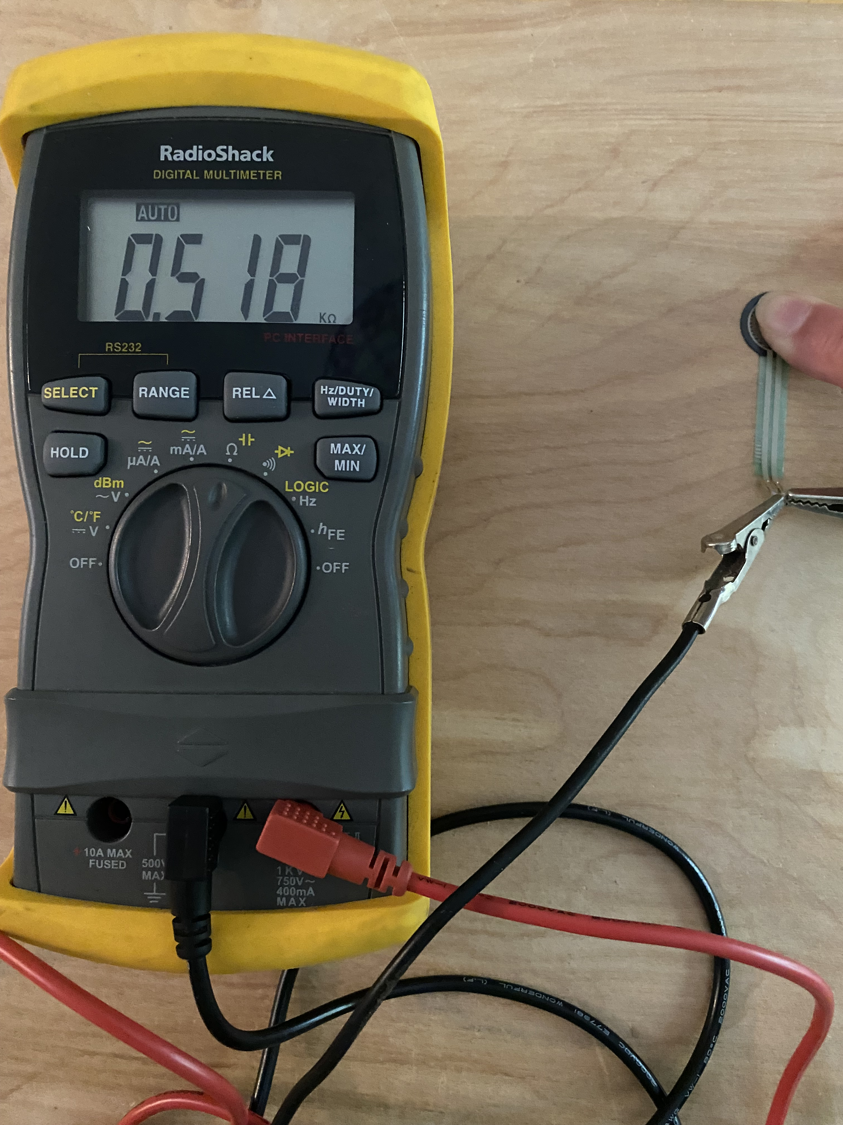
Measuring Resistance with a Multimeter
Just like general purpose fixed resistors, FSRs are not polarized, meaning you do not need to differentiate between the two terminals and the resistance is measured in ohms. In this activity you will attach the multimeter probes to the two FSR terminals and measure the resistance with a multimeter.
A multimeter places a known voltage at the two probes causing current to flow through the resistor. It is best to measure resistance on a component when it is disconnected from any circuit.
If your multimeter has an AUTO range function, the units (mΩ, Ω, kΩ), will automatically adjust. Otherwise, you will need to adjust the range with a switch.
Alligator Clips and FSR
Measuring Resistance

